Slide 1
USA Residency Application for IMG’s
Internship Info Session 2015
Dana Chemali

Slide 2
Overview
ECFMG Certification
ERAS
National Residency Matching Program (NRMP)
Timeline Summary
Visas
USMLE Step 3
Statistics
Resources

Slide 3
ECFMG Certification
Educational Commission for Foreign Medical Graduates
Be a graduate of a medical school listed in the World Directory
USMLE Step 1
USMLE Step 2 Clinical Knowledge (CK)
USMLE Step 2 Clinical Skills (CS)
ECFMG application
Notes:
Assess if you have all the requirements necessary to apply to the US
ECFMG Certification consists of questions that require applicants to confirm their identity, contact information, and graduation from or enrollment in a medical school

Slide 4
What is the USMLE?
United States Medical Licensing Examination
A three-step examination for medical licensure in the United States

Slide 5
USMLE Step 1
Covers the basic science of medicine, principles underlying health, disease, and therapy
322 multiple choice questions
Application available through ECFMG website
Can be written in Australia
Take during 1st or 2nd year

Slide 6
USMLE Step 2 CK
Clinical sciences of medicine
355 multiple choice questions
Application available through ECFMG website
Can be written in Australia
Take after 3rd year

Slide 7
USMLE Step 2 CS
OSCE style examination
Application available through ECFMG website
Can only be written in the USA
Take after 3rd year

Slide 9
ERAS
Electronic Residency Application Service
Complete MyERAS application, assign documents, and apply to programs
Application will be sent to schools of interested
Application fees are based on the number of programs applied to per specialty
Notes:
Make sure you start researching programs early as not all of them will accept IMG’s.
Most IMGs apply to 20-30 programs

Slide 10
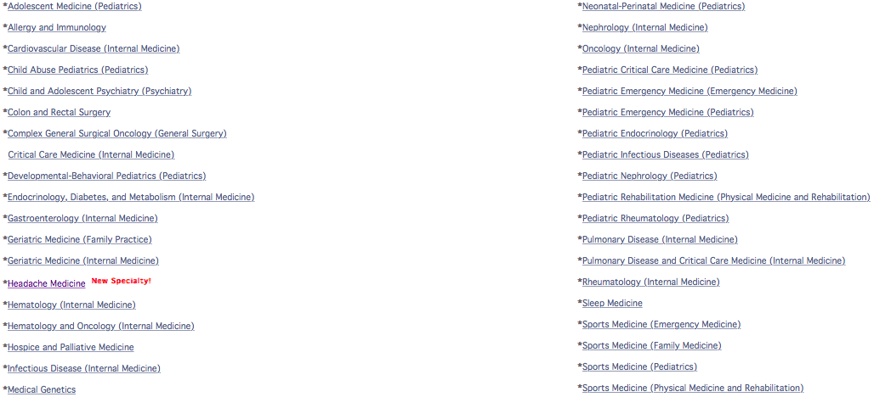
https://services.aamc.org/eras/erasstats/par/index.cfm
Notes:
Every program has different requirements so check early especially if you need clinical experience in the U.S. and what visa is required

Slide 11
NRMP
National Residency Matching Program
Places applicants into residency programs at teaching hospitals depending on the rank order list that you submit
However some specialties do not use NRMP
San Francisco Match (Neurotology, Opthalmology, Plastic Surgery)
Urology: uses ERAS for application but it has its own matching service

Slide 12
Timeline Summary
July: ERAS opens
Mid Sept: NRMP registration opens and apply to programs
January: NRMP rank order list
Mid/Late March – Match results
July: begin residency
http://www.ecfmg.org/echo/eras-timeline.html
Notes:
Would start residency in july of that year
Whole process takes about a year on top of having to write the exams

Slide 13
American Visa
J-1 Visa
Non – immigrant visa
Must return home after completing residency
Restrictive but easy application
H-1B Visa
Temporary worker
Passing score of USMLE Step 3 required
Can be changed to PR or green card
Hard to get

Slide 14
USMLE Step 3
Clinical medicine – patient care and clinical decision making
Eligibility:
Hold an MD degree
Passed Step 1, Step 2 CK, Step 2 CS
obtain certification by the ECFMG
Only available in the U.S.
Two day exam

Slide 15
General Advice
Once you pass a USMLE test, cannot be retaken
Study aids
First Aid for USMLE
Kaplan courses
USMLE World Qbank
Goljan pathology
Start your research early
Plan your timeline early – it is a lengthy process

Slide 16
2014 Results
Of the 12,387 IMGs who participated in the 2015 Match, 6,302 (50.9%) matched
Of the 7,366 IMG participants who were not U.S. citizens, 3,641 (49.4%) obtained first-year positions.

Slide 17
Resources
http://www.ecfmg.org
http://www.usmle.org
https://www.aamc.org/students/medstudents/eras/eras_faq/
http://www.nrmp.org
http://www.nrmp.org/match-data/main-residency-match-data/

