Slide 1
Applying for an internship
Kunal Luthra, Chair

Slide 2
What is MSCV?
Medical Student Council of Victoria
Established in 2007
Represent Victorian medical students and connect MedSocs
University of Melbourne (UMMSS)
Monash University (MUMUS)
Deakin University (MEDUSA)
Notre Dame Sydney’s Melbourne Clinical School (MANDUS)
Representation: AMSA, PMCV, AMA, DoH,

Slide 3
Internship Update
Initial worry this year about the number of positions available for P1 candidates
PMCV and DHHS worked hard to increase the number of accredited places available
798 total positions listed
Slightly over 50% of P2 candidates were matched last Thursday

Slide 4
Applying to Vic
http://www.computermatching.pmcv.com.au/public/matches/intern.cfm
Key points
Overview of timeline
Z scores
Standardised CV + Monash CV
Referees
CPL
Cover letters
Interviews

Slide 5
Applying to Vic
Timeline in 2015
Apr 17 – match opened
May – heath service applications opened
Jun 3 – last day to register and nominate referees
June – interviews and further hospital processes
Jul 1 – last day to reorder preferences
Jul 13 – P1 offers
Aug 13 – P2 offers

Slide 6
Z scores
Mean: 3.5
Standard deviation: 1.0
Compared against the cohort you completed MD3 with
University of Melbourne weighted approximately 1/3 preclinical to 2/3 clinical

Slide 7
Standardised CV
Boxes:
Education and qualifications
Clinical placements
Employment history
Volunteering history
Achievements and awards
Research, publications and presentations
Leadership roles and extracurricular activities
Personal interests

Slide 8
Standardised CV
Very few rules, use your discretion
Generally advised to:
Not tamper with the template
Not make it too long (5 pages is potentially a good number)

Slide 9
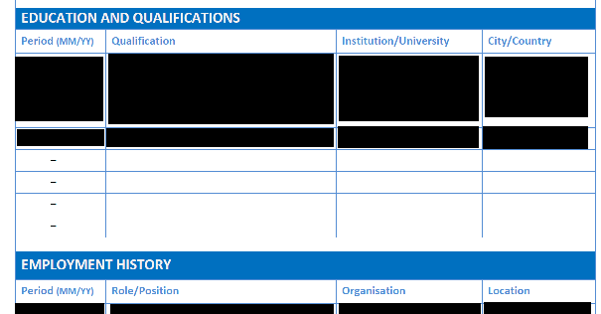
Monash CV
Essentially the same categories, template less adjustable

Slide 10
Referees
The rules
2 referees nominated
You are allowed to look at your reference and change it (contrary to official documents)
Registrars not recommended
Should be clinical referees (some hospitals request a non-clinical reference separately)
Should be from the last 1-2 years
Should be from Australia
Should be from different specialties

Slide 11
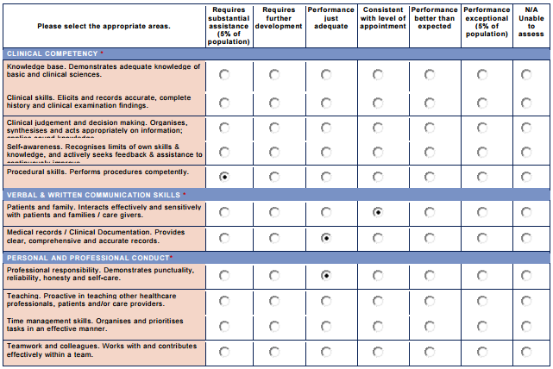
Referees

Slide 12
CPL
One key point: order in terms of your preference, hospitals do not know what your order of preferences is

Slide 13
Individual hospital applications
Most open in mid-May
A link from the hospital website should take you to their application form
May include additional questions (e.g. Monash question about how to create a mentally healthy workplace, or Alfred questions on whether you had published papers)

Slide 14
Cover letters
All hospitals required apart from
Alfred: needed a 200 word statement in their application
RMH: 150 words
Monash
Northern (needed nothing extra)
One page
Establish why you’re worth hiring and why you want to work at that particular hospital
Generally read by HR and scored

Slide 15
Interviews
Four metro hospitals interviewed
Austin: two 8 minute stations, selected first 200 interviewees on marks
RMH: group interview, only if z score > 3.5
Alfred: individual + written component
St Vincent’s: video interview via SONRU
Interviews occur in June, most hospitals shortlist and then offer students options re: when they want to do their interview

Slide 16
Selection
Most hospitals do not reveal their selection weighting
Austin: Selection is 60% marks, 10% CV+cover letter, 25% interview, 5% referee
Eastern: 70% marks, 18% clinical references, 4% non-clinical, 4% CV, 4% cover letter

Slide 17
Intern applicant support group
Join MSCV Intern Applicant Support Group on Facebook to relive this year’s process
There will be another group created next year

Slide 18
Applying interstate
Simpler as mostly ballot based
Official information on relevant websites
Two examples:
Applying to QLD
Applying to NSW

Slide 19
QLD
P2 – domestic interstate students who completed Year 12 in QLD
P3 – domestic interstate students who completed Year 12 elsewhere
P5 – international students graduating from non-NSW universities

Slide 20
QLD
Candidate user manual on their website
Need to upload a range of documentation (Hep B status, police check, English langauge test results)
Need two nominated clinical referees and a CV
Then enter your preferences

Slide 21
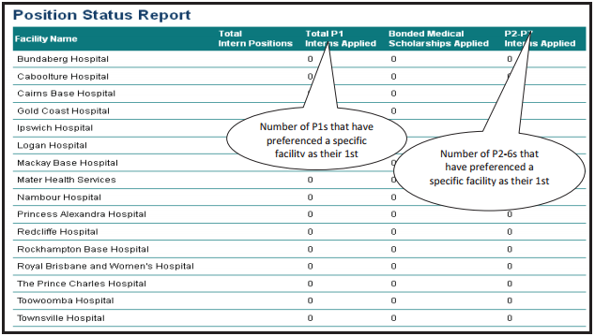
QLD

Slide 22
QLD
P2-7 applicants successful at selection in later round receive an email on their offer
You get the opportunity to change your preferences based on what happened to P1 candidates
Swaps are an option
Any late vacancies are filled on merit

Slide 23
NSW
Cat 2 – domestic interstate students who completed Year 12 in NSW
Cat 3 – domestic interstate students who completed Year 12 elsewhere (application fee of $250)
Cat 5 – international students graduating from non-NSW universities

Slide 24
NSW
Just need to upload requested certified documents onto the website
You apply to networks containing one major tertiary provider and usually some rural hospitals
Four recruitment pathways: Aboriginal Medical Workforce, Rural Preferential Recruitment (involves interviews and preferencing), Direct Regional Allocation, Optimised Allocation

Slide 25
CMI
For international students only, need to have met English language requirements
Applications from the hospitals to participate in the CMI end on 27 Aug
24 Aug – 7 Sep = application period
Oct/Nov = recruitment period
Hospitals get given a list of eligible applicants and run their own processes

Slide 26
CMI
Greenslopes (Ramsay Private Hospital System). Places projected: 50
Bundaberg. Places Projected: 13
Mackay. Places Projected: 2
Townsville. Places Projected: 10
New South Wales (Mater Private System). Places Projected: 5
Western Australia. Places Projected: 10

Slide 27
Contact & Questions
Kunal Luthra
MSCV Chair
0415 031 407
chair@mscv.org.au
www.mscv.org.au
Facebook: MSCVictoria

