Slide 1
PMCV & VIC Intern application

Slide 2
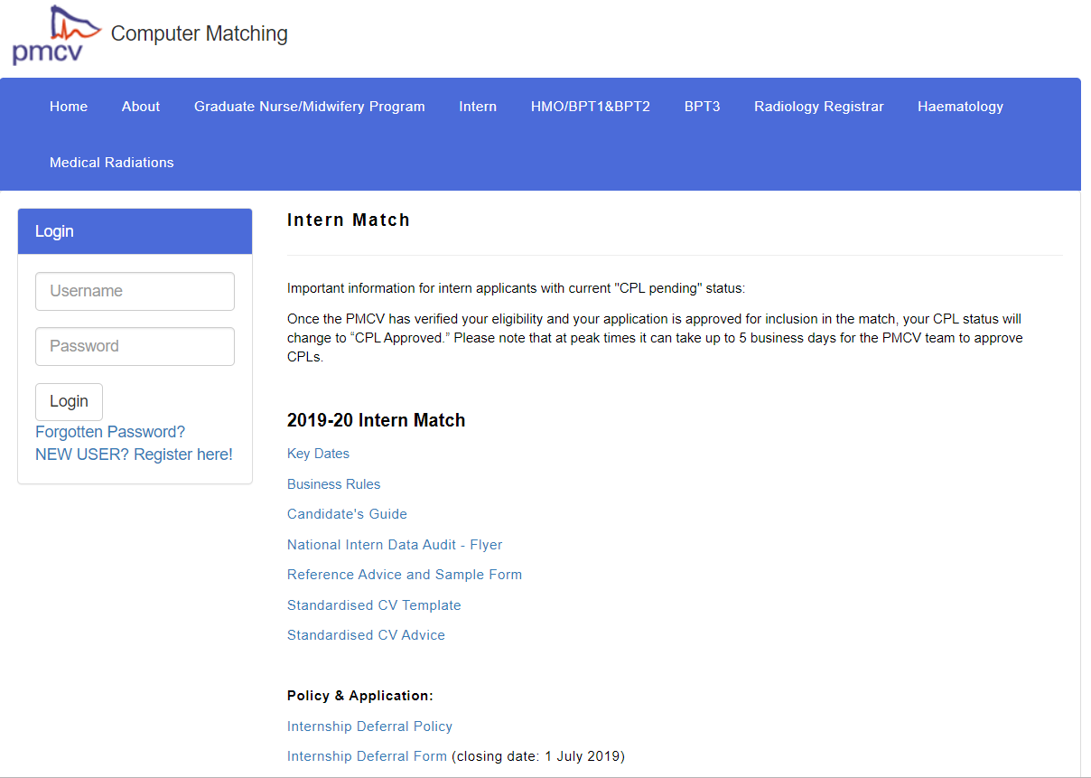
PMCV (Postgraduate Medical Council of Victoria)
Computer Matching
https://computermatching.pmcv.com.au/public/matches/intern.cfm

Slide 3
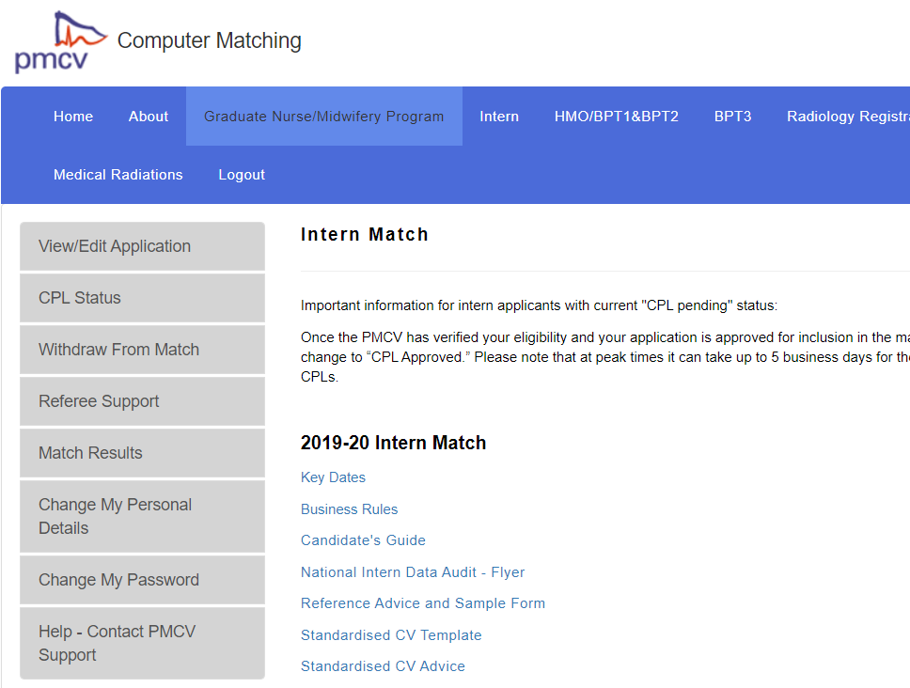
When PMCV Match Opens (generally early May):
Register with PMCV:
View/Edit Application
CPL/Hospital Ranking (15 health services maximum)
Referee Submission (2 clinical references required)
CV upload
Match Results

Slide 4
(Mid April)
15th April 2019
Extended Literature Review Due
(Early May)
8th May 2019
PMCV Match Opens
Application to Vic Health Services Opens
(Early June)
7th June 2019
PMCV Match Closes
Application to Vic Health Services Closes
Cannot add anymore health services to your preference list
Can reorder your preference list
Can delete health services from your preference list
(Early July)
8th July 2019
Monograph Due
Mid – End June
Interview Period
(Early July)
1st July 2019
Last day to submit/reorder preferences on PMCV
(Mid July)
15th July 2019
Priority Group 1 Match Release
Mid August
19th August 2019
Priority Group 2 Match Release

Slide 5
VIC application
23 health services in total;
Maximum of 15 health service preferences;
Requires application to each health services;
Look up requirements for that particular health service
Cover letter
Online application form(s)
May have additional questions on their online application process
Clinical reference(s)
Non-clinical reference(s)
Academic transcript (VIC – Z score)
CV – standardised CV
Interview

Slide 6
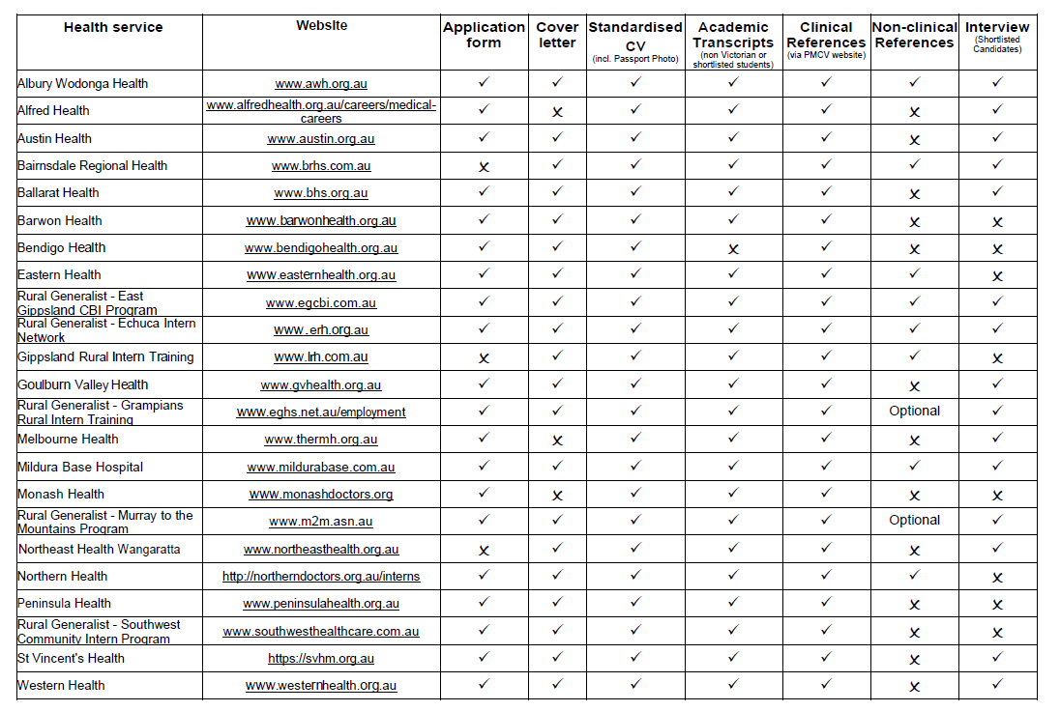

Slide 7
General Tips for VIC P2 applicants:
Pick the 15 health services wisely
Mixture of inner metro/outer metro and rural hospitals
Ranking preferences should be based on where you want to go
Take time to visit rural health services
Make yourself known to rural health services, especially medical workforce
However, this will not guarantee that the health service will rank you higher than someone who did not visit the health service
If you want to know more about a particular health service but have not had the chance to visit, make sure you talk to them at the AMA expo
AMA expo
Talk and make yourself known to interns/medical workforce
Time for you to get to know about the health service
Electives
Make yourself known, get contacts of the supervisor you were with (preferably consultants)

Slide 8
Z score
Don’t forget that your Z-score matters, aim to be >3.5 (above average)
Clinical school
Each clinical school will most likely take their own clinical school students
Make an impression

Slide 9
General CV tips:
Search and familiarize yourself with PMCV standardised CV template;
Do your best to get involved in societies, organizations – these experiences can be used in interviews as well;
Try filling it now and see which areas you might be lacking in/things you think you can work on more;
Get involved with clinical school activities;

Slide 10
General Cover Letter tips:
Specific to the health service
Each health service has their own specific values e.g. Western – diversity, St V – Compassion etc.
Include names of medical workforce or consultants in the cover letter – show connections
Try not to repeat what you have on your CV, rather include personal experiences

Slide 11
Questions?
Stephquah94@gmail.com

