Slide 1
Cover Letters
and
Rural Internships
Andreas Hendarto MD

Slide 2
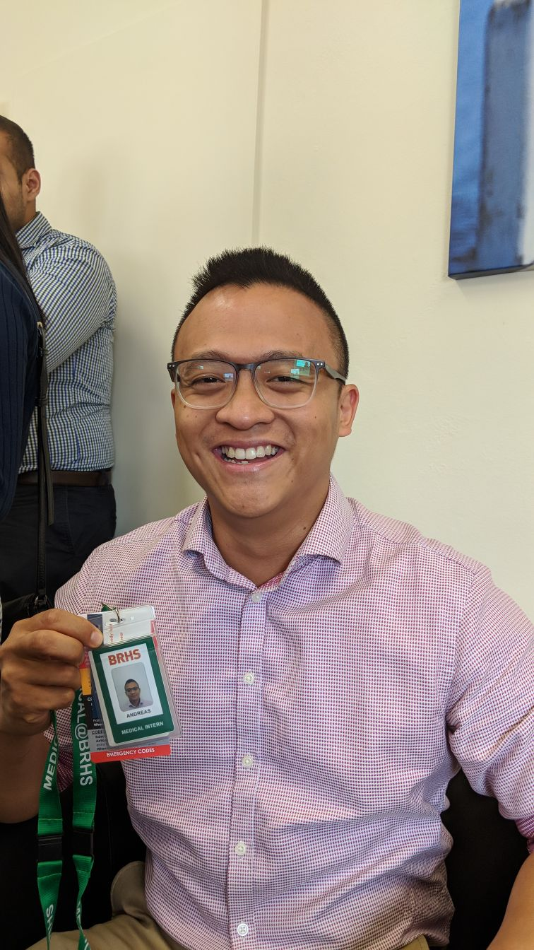

Slide 3
Selling yourself - 3 Key Points
Make no mistake - this is all about selling yourself to multiple employers
The people reading your letters and CV’s are human too; if you earnestly appeal to them through the written word, it becomes a powerful tool
But be real: Metro hospitals do tend to weigh Z-scores far heavier than rural hospitals and programs, who tend to look for personalities who will fit instead

Slide 4
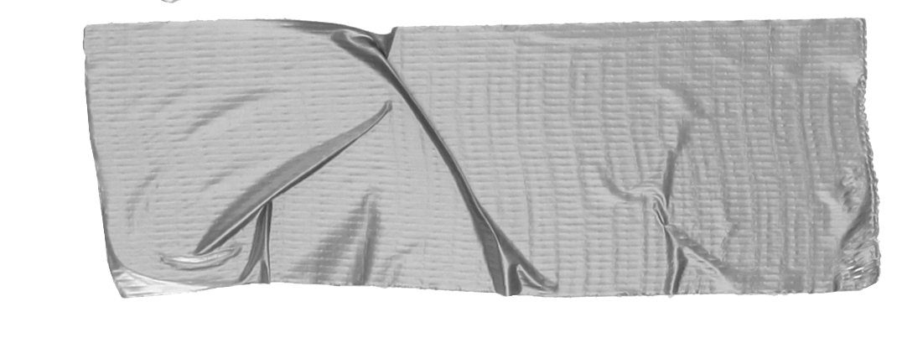
1. Intro
Choose one approach to grab the reader’s attention right from the start: unexpected, emotional, or simple.
Unexpected Highlight what’s new, unusual, or surprising.
Emotional Give people a reason to care.
Simple Provide a simple unifying message for what is to come

Slide 5
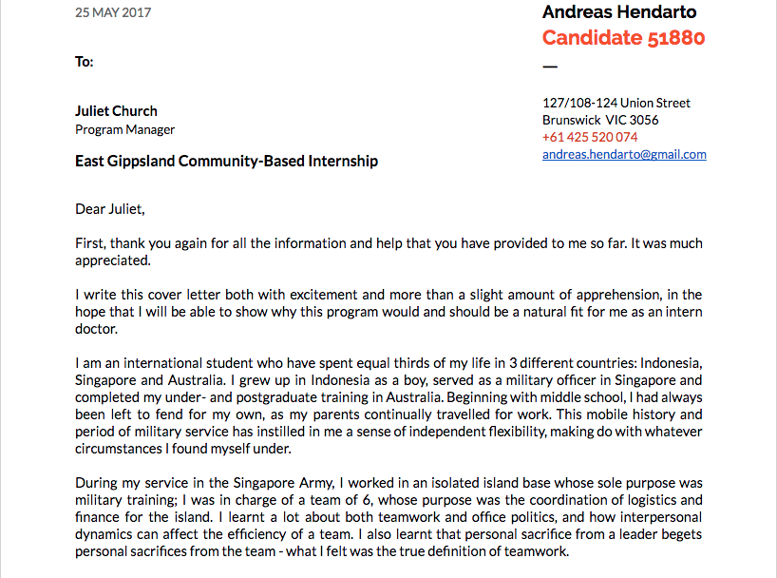
Anatomy of a Cover Letter
To Whom?
BE CLEAR ABOUT WHO YOU ARE
Never leave them guessing about your personal details; you must always make it easy to be remembered!

Slide 6
Anatomy of a Cover Letter
Make them care!
If you had had contact with them, highlight that fact, even though they may not remember.
Give them some insight as to what your frame of mind is as an applicant: excited, nervous, keen?

Slide 7
Anatomy of a Cover Letter
You are unique
How are you unique? Where do you come from? How did you come to be?
Dig deep, and show them

Slide 8
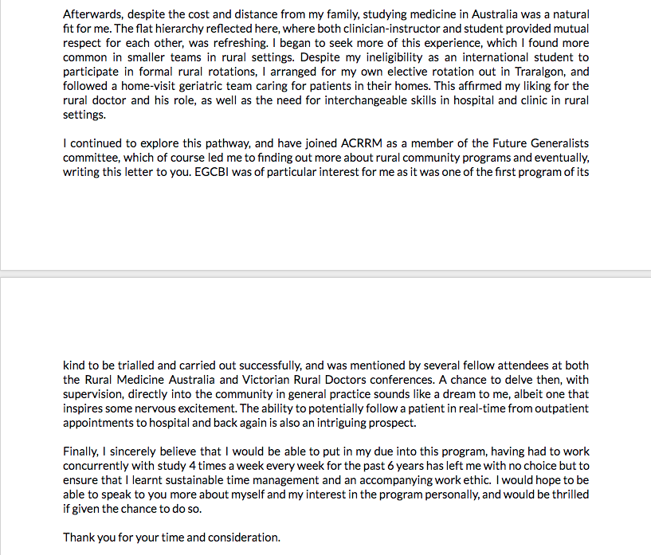
Anatomy of a Cover Letter
Why Australia?
This is an element unique to us - as international students we have various reasons for staying - what’s yours?

Slide 9
Anatomy of a Cover Letter
What you’ve done to further your interests
This varies from individual to individual

Slide 10
Anatomy of a Cover Letter
What you’ve done to further your interests
This varies from individual to individual

Slide 11
2. Rural? Me?
What What is a rural internship?
Who What kind of people are they looking for?

Slide 12
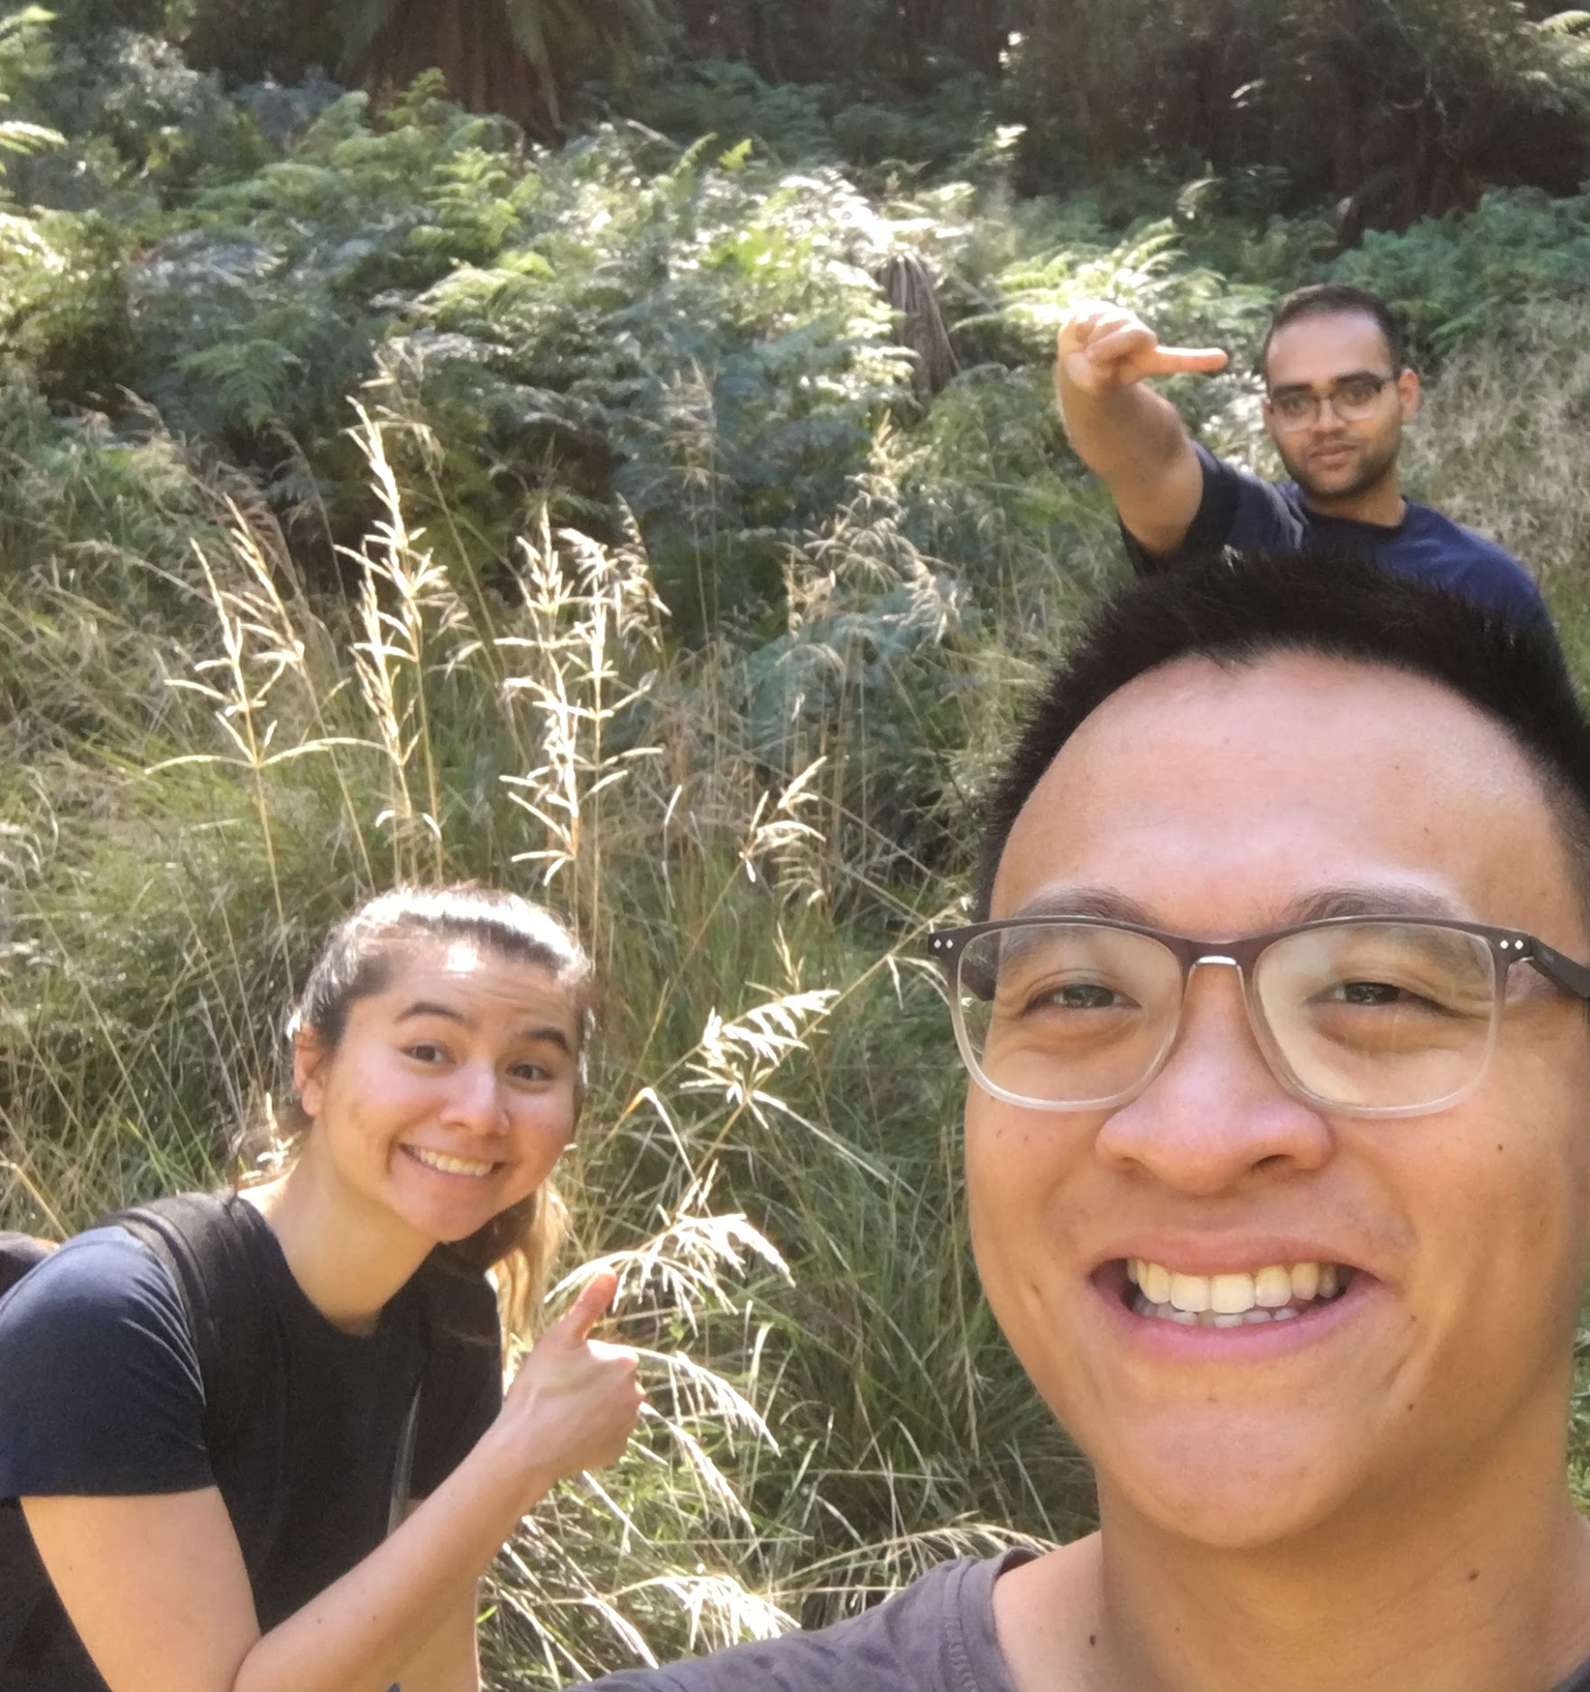
Tip
Figure out the interviewer’s main question - then answer it!
Meet you.
You are a known quantity to an interviewer - especially a rural one. They’ve made an effort to pick you out.
Interviews are given so that interviewers can find answers to certain questions they want answered

Slide 13
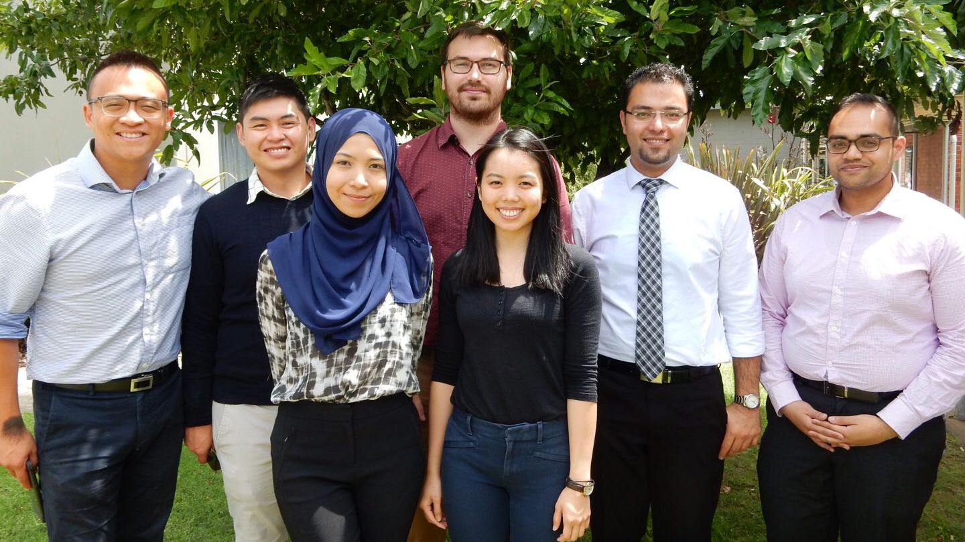
Remember, you have nothing to lose
Be honest and frank - people can tell if you’re bluffing

Slide 14
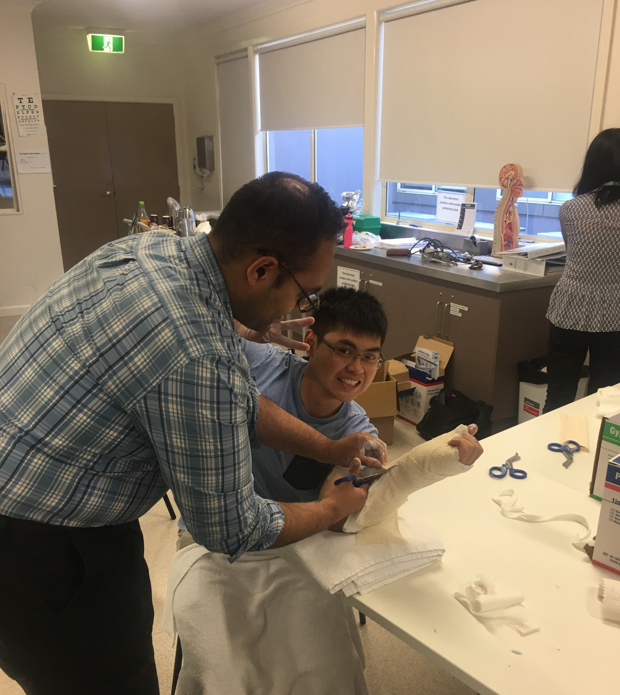
Tip
If you don’t know the diagnosis, share your thought process with the interviewer - it’ll show them that you understand the role of a junior doctor
Clinical knowledge
Have a quick look at common clinical cases and presentations - it pays to at least know what to look out for in a clinical setting
That being said, metropolitan interviews can dedicate nearly half their time to clinical questions

Slide 15
Milestones
May 2018
July 2018
September 2018
June 2018
August 2018
PMCV applications open
P1 applicants receive their offers for Round 1; Round 1.5 commences
CMI applications open
Internship 2019
PMCV applications close
P2 applicants receive their offers for Round 2; Round 3 commences

Slide 16
Take away messages
Dig deep, and write earnestly about why you’re applying
Don’t discount any opportunities - internship’s a job, it does not define you!
Don’t despair - many have waited until early the next year to get a job

Slide 17
Good luck!
I hope you’ll use these tips to go out and get yourself a job and an experience of a lifetime
Your career is starting soon!

