Slide 1
Canadian Residency Application for IMG’s
Internship Info Session 2015
Dana Chemali

Slide 2
Overview
Physiciansapply.ca
Eligibility criteria
CaRMS
MCCEE
NAC OSCE
MCCQE Part 1 and 2
Websites

Slide 3
physiciansapply.ca
Launched in May 2013
Centralized portal
Apply for MCC exams and view results
Validate document required for licensure and certification of IMG’s
Shares relevant documentation with CaRMS

Slide 4
Eligibility Criteria
Medical degree must be from a medical school listed with LCME or World Directory of Medical Schools
Has obtained or in process of obtaining degree by July 1st
Must be a Canadian citizen or hold PR
Written and passed the MCCEE by March
Written and passed the NAC examination by September
Proof of proficiency in one of 2 official languages (English or French)

Slide 5
Eligibility Criteria
Alberta
Must be deemed eligible by Alberta International Medical Graduate Program (AIMG) to participate in CaRMS match process
6 months Alberta residency or 2 years Alberta senior high school or 2 years full-time Alberta undergraduate postsecondary study
Québec
Collège des médecins du Québec equivalency process by end of November
MCCEE, MCCQE Part I, MCCQE Part II or NAC-OSCE
French universities require you to take the same test in french
Notes:
On top of being canadian, having you medical degree from acredited medical school, having completed MCCEE

Slide 6
CaRMS
Canadian Resident Matching Service
2 Iterations (rounds)
Documents required
School transcript
Examination results
Dean’s letter
Reference letters
Personal letter

Slide 7
CaRMS Timeline
First iteration
Application opens September 1st 2016
Interview period: January 14th – February 5th 2017
Match Day: March 1st 2017
Second iteration
Application opens: January 5, 2017
Match Day: April 11th, 2017
Notes:
If you are not matched you are automatically registered into the 2nd iteration

Slide 8
MCCEE
Medical Council of Canada Evaluating Examination
Four-hour, computer-based examination
180 multiple-choice questions
Child, Maternal, Adult, Mental, and Population Health and Ethics
Standard-score scale that ranges from 50 to 500
Must be written in final 20 months of medical program
Offered via Prometric
Fees 2015: $1,695
Notes:
There are prometric centres in australia
Can only retake if you fail
Once you have passed that, you can write the MCCQE and NACOSCE

Slide 9
NAC OSCE
National Assessment Collaboration Objective Clinical Examination
Comprised of Clinical stations
Offered in only in Canada once a year
Fee: $2,230

Slide 10
MCCQE I and II
The Medical Council of Canada Qualifying Examination
Part I
Morning session MCQ
Afternoon session Clinical decision making component
Fee: $980
Notes:
MCCQE 1 not a requirement in order to apply to Residency but the majority of IMG will do it to strengthen their application

Slide 11
MCCQE I and II
Part II
Comprised of clinical stations
Must be completed after 12 months of postgraduate medical training
Don’t worry about this until after starting residency

Slide 12
Provincial Criteria
 | Return of service | First Iteration | Second Iteration
Ontario | Yes | Parallel | Competitive
BC | Yes | Parallel | Competitive
Quebec | No | Competitive | Competitive
Alberta | No | Parallel | Competitive
Saskatchewan | Yes | Parallel | Competitive
Nova Scotia | Yes | Parallel | Competitive
Newfoundland | Yes | Parallel | Competitive
Notes:
Newfoundland didn’t used to require NAC OSCE but now it is a requirement

Slide 13
Timeline Summary
20 months before graduation (3rd year)
Register with physiciansapply.ca
Write MCCEE
4th year
Write NAC OSCE (March or September)
Study and take MCCQE Part 1
Register with CarMS and submit application (September)
Year after graduation
Interview (January to February), March results (March)

Slide 14
2015 Match Results
1445 IMG’s Unmatched
351 IMG’s Matched
Family Medicine (185)
Internal Medicine (56)
Psychiatry (28)
Paediatrics (19)
Of the 73 Oceania/Pacific Island IMG graduates, 46 Matched

Slide 15
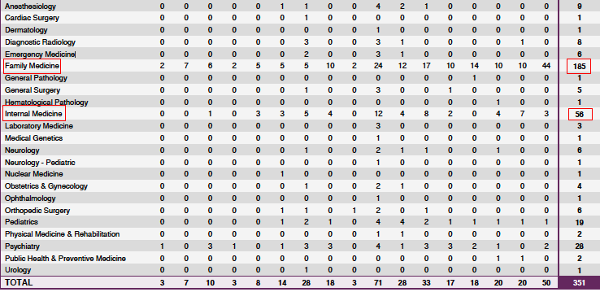
2015 Match Results

Slide 16
Resources
http://physiciansapply.ca
http://www.carms.ca/en/applicants/csa/
http://mcc.ca/home/
Study resources
MCCEE online practice test
CanadaQbank
Toronto Notes
USMLE Step 2 CK

