Slide 1
Becoming a Junior Doctor in Singapore
UMMSS International Internship Information Night
13 Sep 2016
Sean Ezekiel Seow (RMH, MD4 2016)
sseow@student.unimelb.edu.au
Adapted from slides by Dr Richard Lu (MD4 2015)

Slide 2
Disclaimer
The author of this presentation has made every effort to ensure the accuracy of the information, however is not responsible for any inadvertent errors.
In any doubt, check with official sources first-hand.
Any opinions expressed are the author’s own and do not represent the views of any agencies or organisations.

Slide 3
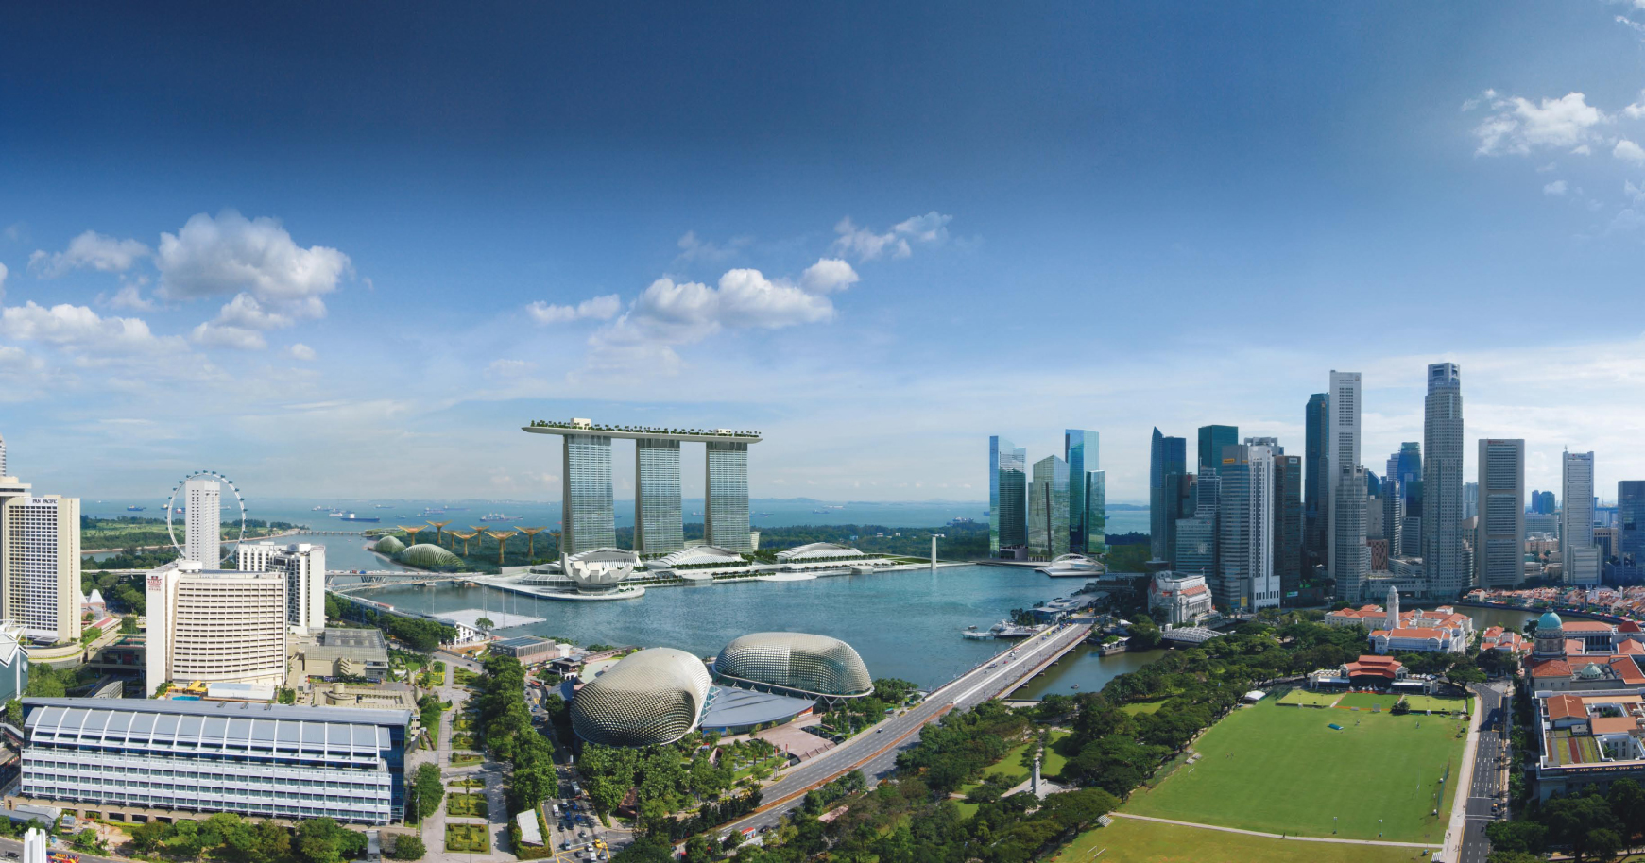
Singapore 1.3521° N, 103.8198° E

Slide 4
Registration
The Melbourne MD and MBBS are both recognised by the Singapore Medical Council (SMC)
No additional exams to work as a medical practitioner in Singapore
http://www.smc.gov.sg/
PGY 1 = House Officer (HO) aka Intern
Work as a House Officer (HO) under Provisional Registration
Satisfactory completion of PGY1 required to gain Conditional Registration
PGY2 = Medical Officer (MO) aka HMO2
Completion of internship in Australia is recognised for Conditional Registration
Conditional Registration requires supervised practice, 2 years for Singaporeans and 4 years for SPRs/foreigners) prior to Full Registration (this is for non-specialists)

Slide 5
Application and Employment
Employment by a single body: MOH Holdings (MOHH Pte Ltd)
Holding company of Singapore’s public healthcare assets
Common employer of all junior doctors in Singapore
Coordinates the posting of house officers and medical officers
Coordinates the residency application process

Slide 6
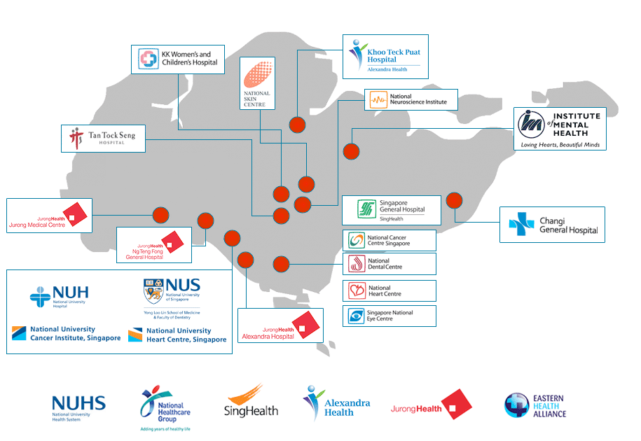
Public Healthcare Institutions in Singapore

Slide 7
PGY1 –House Officer
House Officer (HO) equivalent to Intern in Australia
3 x 4-month rotations
4 months of General Medicine +
4 months of General Surgery / Orthopaedic Surgery +
4 months of Gen Med / Gen Surg / Ortho / O&G / Paediatrics
You can preference your rotation combinations and which hospitals you would like to do each rotation in
Orientation and work commences in Feb/March after graduation

Slide 8
What Happens after PGY1
Become a Medical Officer (MO) with similar responsibilities as HMO2+ in Australia
If you have decided what specialty you want to do, apply for residency (specialist training program)
If you are still unsure of which residency to go for or fail to match to a program
Medical Officer Posting Exercise (MOPEX)
6-month rotations in almost any specialty and institution (by preference and availability)
Try out different things and network with potential referees

Slide 9
Applying for a Job as an HO
Apply to MOHH
http://www.physician.mohh.com.sg/medical_service_scheme.html#ready_to_apply
Submit application to physician@mohh.com.sg with:
Completed employment application form http://physician.mohh.com.sg/download/MOHH_Employment_Form.pdf
CV
Academic transcripts
Copy of passport
Photograph
Names of 2 professional referees
NO OFFICIAL CLOSING DATE
But submit before the end of June (the earlier the better) in order to secure an interview spot

Slide 10
Interview
Employment interviews held in Melbourne
~July (30-31 July 2016 this year)
Panel interview
Mix of general and clinical questions
Recent focus on clinical questions
Same process for interns/HMOs in Melbourne who wish to apply for a MO position
NOTE: While it is not difficult to gain employment as a HO in Singapore, PGY1 positions are becoming saturated in recent years and you should not treat this as an absolutely fail-safe backup

Slide 11
Residency in Singapore
Structured specialist training modelled after the US system (with elements from the UK such as exams)
3-8 years depending on specialty and sub-specialisation then exit as a specialist (Associate Consultant)
You DO NOT have to enter a residency program to work as a doctor in Singapore (Resident Physician)
Residency programs are run under 3 Sponsoring Institutions, each comprising a cluster of healthcare institutions
SingHealth http://www.singhealthresidency.com.sg/
National University Health System (NUHS) http://www.nuhs.edu.sg/nuhsresidency/
National Healthcare Group (NHG) https://www.nhgresidencyprogram.com.sg/

Slide 12
Residency Programs
Can apply as a MD4 and enter at PGY1
Internal Medicine (5-6.5 years)*
General Surgery (5 years)
Emergency Medicine (5 years)
Paediatrics (6 years)
Preventive Medicine (5 years)
Psychiatry (5 years)
Can apply as a MD4 but enter after PGY1
Anaesthesiology (5 years)
Diagnostic Radiology (5 years)
Family Medicine (3 years)
Obstetrics and Gynaecology (6 years)
Ophthalmology (5 years)
Orthopaedic Surgery (6 years)
Otorhinolaryngology (5 years)
Pathology (5 years)
Can only apply as a HO/MO
Cardiothoracic Surgery (6 years)
Neurosurgery (6 years)
Urology (6 years)
Plastic Surgery (6 years)
Hand Surgery (6 years)
Radiation Oncology (5 years)
*Internal Medicine Senior Residency
(after 3 years of IM Junior Residency)
Advanced Internal Medicine (2 years)
Cardiology (3.5 years)
Dermatology (3.5 years)
Endocrinology (3 years)
Gastroenterology (3 years)
Geriatric Medicine (3 years)
Haematology (3 years)
Infectious Diseases (3 years)
Medical Oncology (3 years)
Neurology (3 years)
Nuclear Medicine (2 years)
Renal Medicine (3 years)
Rehabilitation Medicine (3 years)
Respiratory Medicine (3 years)
Rheumatology (3 years)

Slide 13
Applying for Residency
You need to secure employment with MOHH first (i.e. submit job application and attend the employment interview in Melbourne)
4-station Multi-Mini Interview (non-clinical scenarios, 10 minutes each) IN SINGAPORE in November
Those who pass the MMI → ranking and matching process
If matched, enter program in July the following year for direct entry programs
Difficult but not impossible for IMGs to successfully match as a medical student. It becomes easier after you have worked in the system for a while and people know who you are
Only apply if you know which specialty you want and only apply for the specialties you want – if you back out you will be barred from applying for one year
Have a good read through the residency website at http://physician.mohh.com.sg/residency/index.html

Slide 14
Find out More: MOHH Info Sessions
MOHH comes down to Melbourne in March every year to hold career information sessions
Topics covered
Medical career in Singapore
Remuneration and benefits
Residency and application process
Employment interviews are usually held in Melbourne around July/August
Keep an eye out for details on http://physician.mohh.com.sg/ for details and updates

Slide 15
The Pros
Arguably one of the most advanced medical hubs in the region
High job security (you don’t have to apply for a job every year)
High patient volume therefore amazing variety of cases and very rigorous training
Many opportunities to train in highly specialised tertiary centres and also with the expanding public healthcare system in the next few years
Relatively low cost of living (unless you wish to own a car)
Fantastic CHEAP food, not to mention often free food during teaching sessions (no more Zouki thank goodness)

Slide 16
Potential Challenges
Long hours, heavy workload and very fast pace
Normal day is 0700-1700 but can be longer in surgical units (0530-2000)
‘Call’ system: HOs work from 7am to 12+pm the next day (30 hours straight), ~4 times a month
Slowly moving to a “night float” system
~70+ hours per week for medical rotations and longer for surgical rotations
Lower pay compared to Australia (but taxes are much lower)
Potential language barriers (most patients speak English but some elderly patients only speak Mandarin, various Chinese dialects, Malay or Tamil)
Local culture and slang can take a while to get used to, plus unique terms (hypocount / set plug / blue letter / TCU ???)
Perennial hot and humid weather (some wards don’t have air-conditioning)

Slide 17
To find out what it is really like
Do an elective in Singapore
Guaranteed to be an unique experience ☺
Also helps with networking and finding referees for residency application if you are really keen
Ask your Singaporean classmates
Hopefully you know who we are by now ☺
Many of us have done electives in Singapore and have some experience with the system

Slide 18
Clinical Electives in Singapore
The following hospitals accept direct applications
Singapore General Hospital (SGH) http://www.sgh.com.sg/Education/Undergraduate-Medical-Education/Pages/application.aspx
National University Hospital (NUH) http://www.nuhs.edu.sg/education/medical-education/medical-students/electives.html
Tan Tock Seng Hospital (TTSH) http://www.ttshppeo.com.sg/home/medical/electives-for-overseas-medical-students
KK Women’s and Children’s Hospital (KKH) http://www.kkh.com.sg/educationandtraining/overseaselective/Pages/Paediatrics.aspx
Yong Loo Lin School of Medicine, National University of Singapore (YLLSoM, NUS) coordinates electives for other hospitals as well as the above https://itumed.nus.edu.sg/scep/default.aspx

Slide 19
Thank You
For all information regarding a medical career in Singapore, visit http://physician.mohh.com.sg/ or contact physician@mohh.com.sg
Singapore Medical Council (medical registration) http://www.smc.gov.sg/
Residency Information and Application http://physician.mohh.com.sg/residency/index.html
Residency Sponsoring Institutions
SingHealth http://www.singhealthresidency.com.sg/
National University Health System (NUHS) http://www.nuhs.edu.sg/nuhsresidency/
National Healthcare Group (NHG) https://www.nhgresidencyprogram.com.sg/

